Slide 1
(AWS)Amazon RDS Overview
By
RAVI R

Slide 2
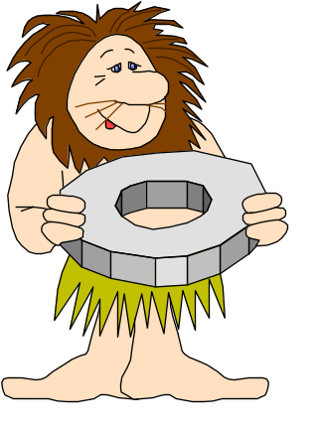
Outline:
Database Definition
AWS – RDS Overview
RDS Benefits
RDS instance creation on AWS Console
5. Database Languages

Slide 3
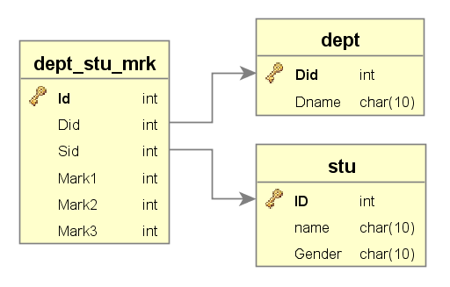

TABLES

Slide 4
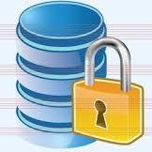

Database Definition
DB:
It is a collection of data, usually describing the activities or records of people, place and things etc
It is collection of logically related files.
DBMS:
Database management system (DBMS) is a software that manages database on a computer.
Eg. Microsoft Access, MySQL, Oracle and DB2 etc.

Slide 5
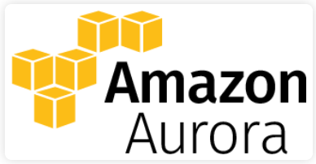
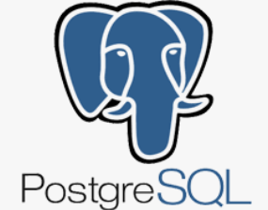
AWS – RDS Overview
RDS (Relational DB Service): Amazon Relational Database Service (RDS) is a managed SQL database service provided by Amazon Web Services (AWS) and providing access to enterprise level db engines for storing and organizing data. It also helps with relational database management tasks, such as data migration, backup, recovery and patching.
Amazon RDS facilitates the deployment and maintenance of relational databases in the cloud. A cloud administrator uses Amazon RDS to set up, operate, manage and scale a relational instance of a cloud database.
A relational database uses tables to store data. It is called relational because it organizes data points with defined relationships.

Slide 6
AWS – RDS Overview
A database administrator can create, configure, manage and delete an Amazon RDS instance, along with the resources it uses. Amazon RDS instance is a cloud database environment.
Amazon RDS limits each customer to a total of 40 database instances per account. AWS imposes further limitations for Oracle and SQL Server instances. With those database instances, a user generally can only have up to 10.
Amazon Aurora: is a relational database service developed and offered by Amazon Web Services beginning in October 2014. Aurora is available as part of the Amazon Relational Database Service (RDS).
Aurora is a fully managed relational database engine that’s compatible with MySQL and PostgreSQL. Aurora offered MySQL compatible service upon its release in 2014. It added PostgreSQL compatibility in October 2017

Slide 7

AWS – RDS Overview
RDS AWS Components:
VPC: Amazon Virtual Private Cloud (Amazon VPC) gives you full control over your virtual networking environment, including resource placement, connectivity, and security.
DB Instances: They are the building blocks of RDS. It is an isolated database environment in the cloud, which can contain multiple user-created databases
Regions and Availability Zones: The AWS resources are housed in highly available data centers, which are located in different areas of the world. This “area” is called a region.
Each region has multiple Availability Zones (AZ), they are distinct locations which are engineered to be isolated from the failure of other Azs.
Security Groups: A security group controls the access to a DB Instance.
DB Parameter Groups: It contains the engine configuration values that can be applied to one or more DB Instances of the same instance type.
Notes:
6

Slide 8
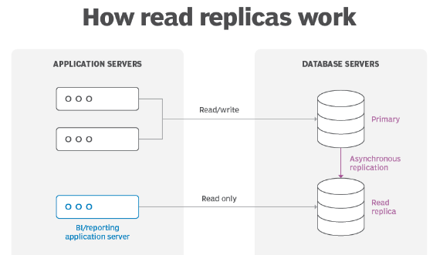
AWS – RDS Overview
Replication. RDS uses the Replication feature to create read replicas. These are read-only copies of database instances that applications use without altering the original production database. Administrators can also enable automatic failover across multiple availability zones through RDS Multi-AZ deployment and with synchronous data replication.

Slide 9
Storage: RDS provides three types of storage:
General-purpose solid-state drive (SSD). Amazon recommends this storage as the default choice.
Provisioned input-output operations per second (IOPS). SSD storage for I/O-intensive workloads.
Magnetic. A lower cost option.
Monitoring:. The Amazon CloudWatch service enables managed monitoring. It lets users view capacity and I/O metrics.
Patching: RDS provides patches for whichever database engine the user chooses.
Backups: Another feature is failure detection and recovery. RDS provides managed instance backups with transaction logs to enable point-in-time recovery.
Encryption: RDS uses public key encryption to secure automated backups, read replicas, data snapshots.

Slide 10
Benefits:
Support Large DB: It helps organizations deal with the complexity of managing large relational databases.
Ease of use: Admin can manage multiple database instances using the management console. it automates manual backup and recovery processes.
Cost-effectiveness. According to AWS, customers only pay for what they use. Also, the time spent maintaining instances is reduced, because maintenance tasks, such as backups and patching, are automated.
Avoid heavy traffic: he use of read replicas routes read-heavy traffic away from the main database instance, reducing the workload on that one instance.
Drawbacks:
Lack of root access: Because it is a managed service, users do not have root access to the server running RDS.
Downtime: Systems must go offline for some patching and scaling procedures.

Slide 11
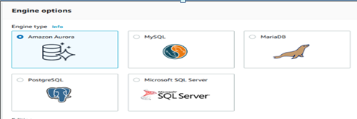
RDS DB Engines:
Amazon Aurora is a proprietary AWS relational database engine. Amazon Aurora is compatible with MySQL and PostgreSQL.
RDS for MariaDB is compatible with MariaDB, an open source relational database management system (RDBMS) that's an offshoot of MySQL.
RDS for MySQL is compatible with the MySQL open source RDBMS.
RDS for PostgreSQL is compatible with PostgreSQL open source object-RDBMS.
RDS for SQL Server is compatible with Microsoft SQL Server, an RDBMS.

Slide 12
AWS – RDS Overview
Amazon RDS' scalability, security and availability make it useful for a variety of applications.
Online retailing. These applications manage complex databases that track inventories, transactions and pricing.
Mobile and online gaming. RDS supports developers that need to continuously update these applications and users who need high availability.
Travel applications. Applications like Airbnb take advantage of RDS' ability to simplify time-consuming database administration tasks and automate database replication.
Streaming applications. Applications like Netflix take advantage of RDS' storage scalability as well, and availability of Amazon RDS, which allows them to handle high demand daily.
Finance applications. These applications, like other mobile applications, can use RDS to simplify administrative database tasks and save time and money.

Slide 13
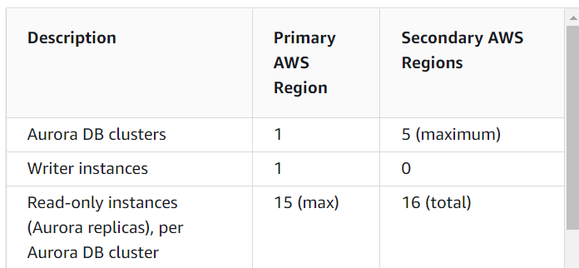
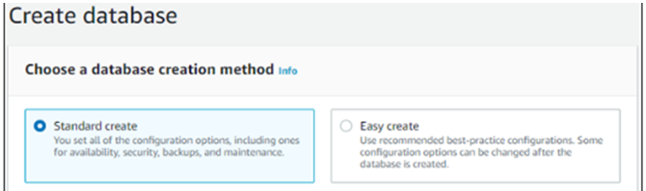
How to create RDS Aurora instance & PostgreSQL DB
Configuration Requirements
Login AWS Dashboard

Slide 14
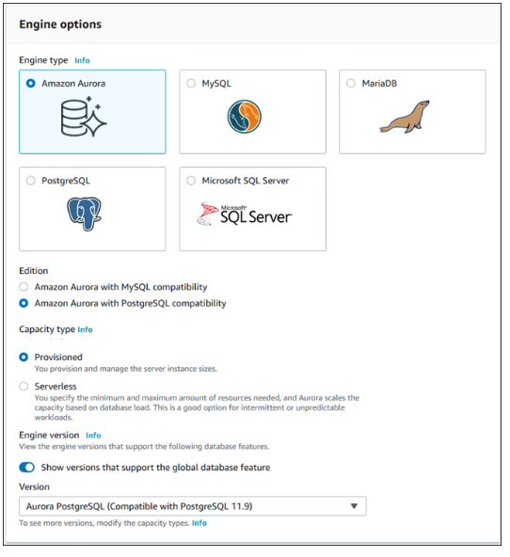
How to create RDS Aurora instance & PostgreSQL DB

Slide 15
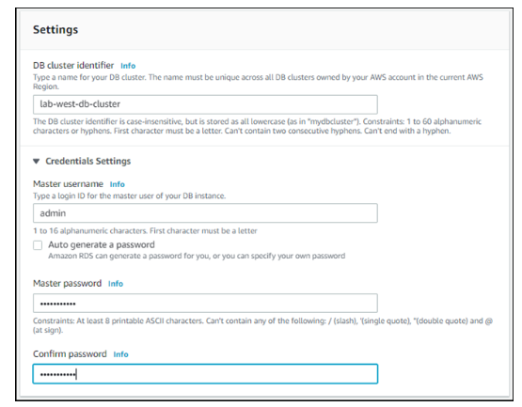
How to create RDS Aurora instance & PostgreSQL DB

Slide 16
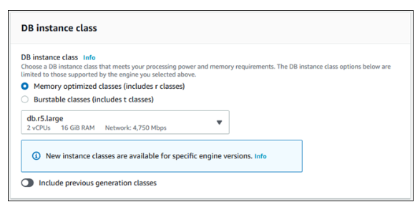
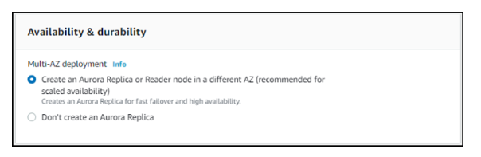
How to create RDS Aurora instance & PostgreSQL DB

Slide 17
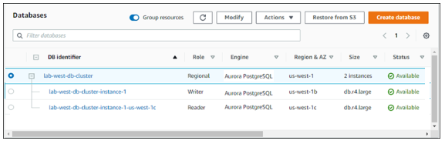
How to create RDS Aurora instance & PostgreSQL DB

Slide 18
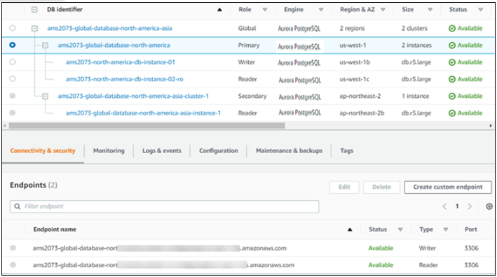
Sample RDS Amazon Auroroa PostgreSQL DB

Slide 19
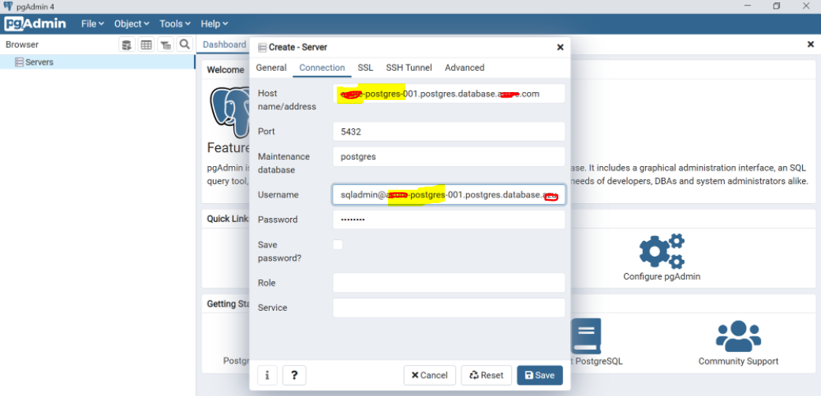
PG Admin Tool – Configure db connection

Slide 20
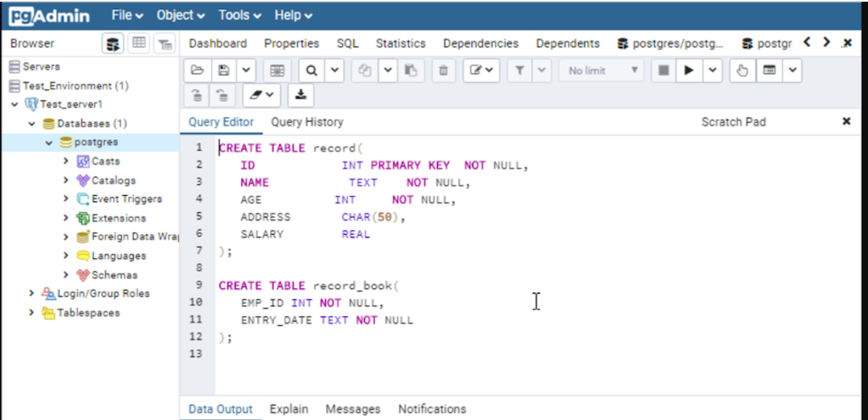
PG Admin Tool – Create objects

Slide 21
Database Languages
DDL – Data Definition Language
CREATE - to create objects in the database.
ALTER - alters the structure of the database.
DROP - delete objects from the database.
TRUNCATE - remove all records from a table, including all spaces. RENAME - rename an object.
DML – Data Manipulation Language
INSERT - insert data into a table.
UPDATE - updates existing data within a table.
DELETE - deletes all records from a table, the space for the records remain.

Slide 22
Database Languages(Cond...)
DRL – Data Retrieval Language
SELECT - retrieve data from the a database.
DCL – Data Control Language
GRANT - gives user's access privileges to database.
REVOKE - withdraw access privileges given with the GRANT command.
DCL – Data Control Language
COMMIT - save work done
SAVEPOINT - identify a point in a transaction to which you can later roll back .
ROLLBACK - restore database to original since the last Commit.

Slide 23



